Slide 1
Cloud Computing Fall 2020
Notes:
Introduction to the Cloud

Slide 2
Overview
Welcome!
Format of this course
Lectures
Exercises
Project work
Deadlines
Grading

Slide 3

Welcome!
Source: Unsplash/Tyler Lastovich under Unsplash License

Slide 4
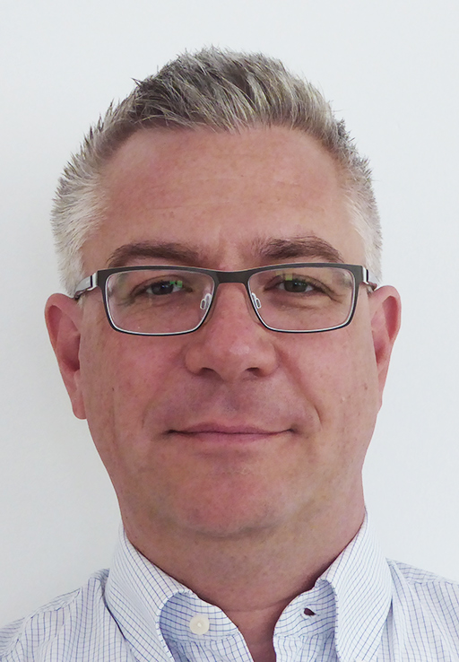
Peter Wenzl
Computer Science Master (Dipl. Ing.) TU Wien, 2000
Telecoms Focused Career
Ericsson Austria
mobilkom Austria
Oracle Austria GmBH (CGBU)
Frequentis AG
Linkedin: linkedin.com/in/peterwenzl/
E-mail: peter.wenzl@edu.fh-campuswien.ac.at

Slide 5
Janos Pasztor
Software developer and DevOps engineer background (10+ years experience)
Cloud Focused Career
Docler Group
IXOLIT
Entrecloud
A1
Deloitte
Certified Kubernetes Application Developer
Website: pasztor.at
Linkedin: linkedin.com/in/janoszen/
E-mail: janos.pasztor@edu.fh-campuswien.ac.at

Slide 6

Format of this course
Source: Unsplash/Morning Brew under Unsplash License

Slide 7
Format overview
Integrated course Theory + Practice
Theory Online Lectures (learn at your own pace)
Practice Individual Project Work (in 3 parts)

Slide 8
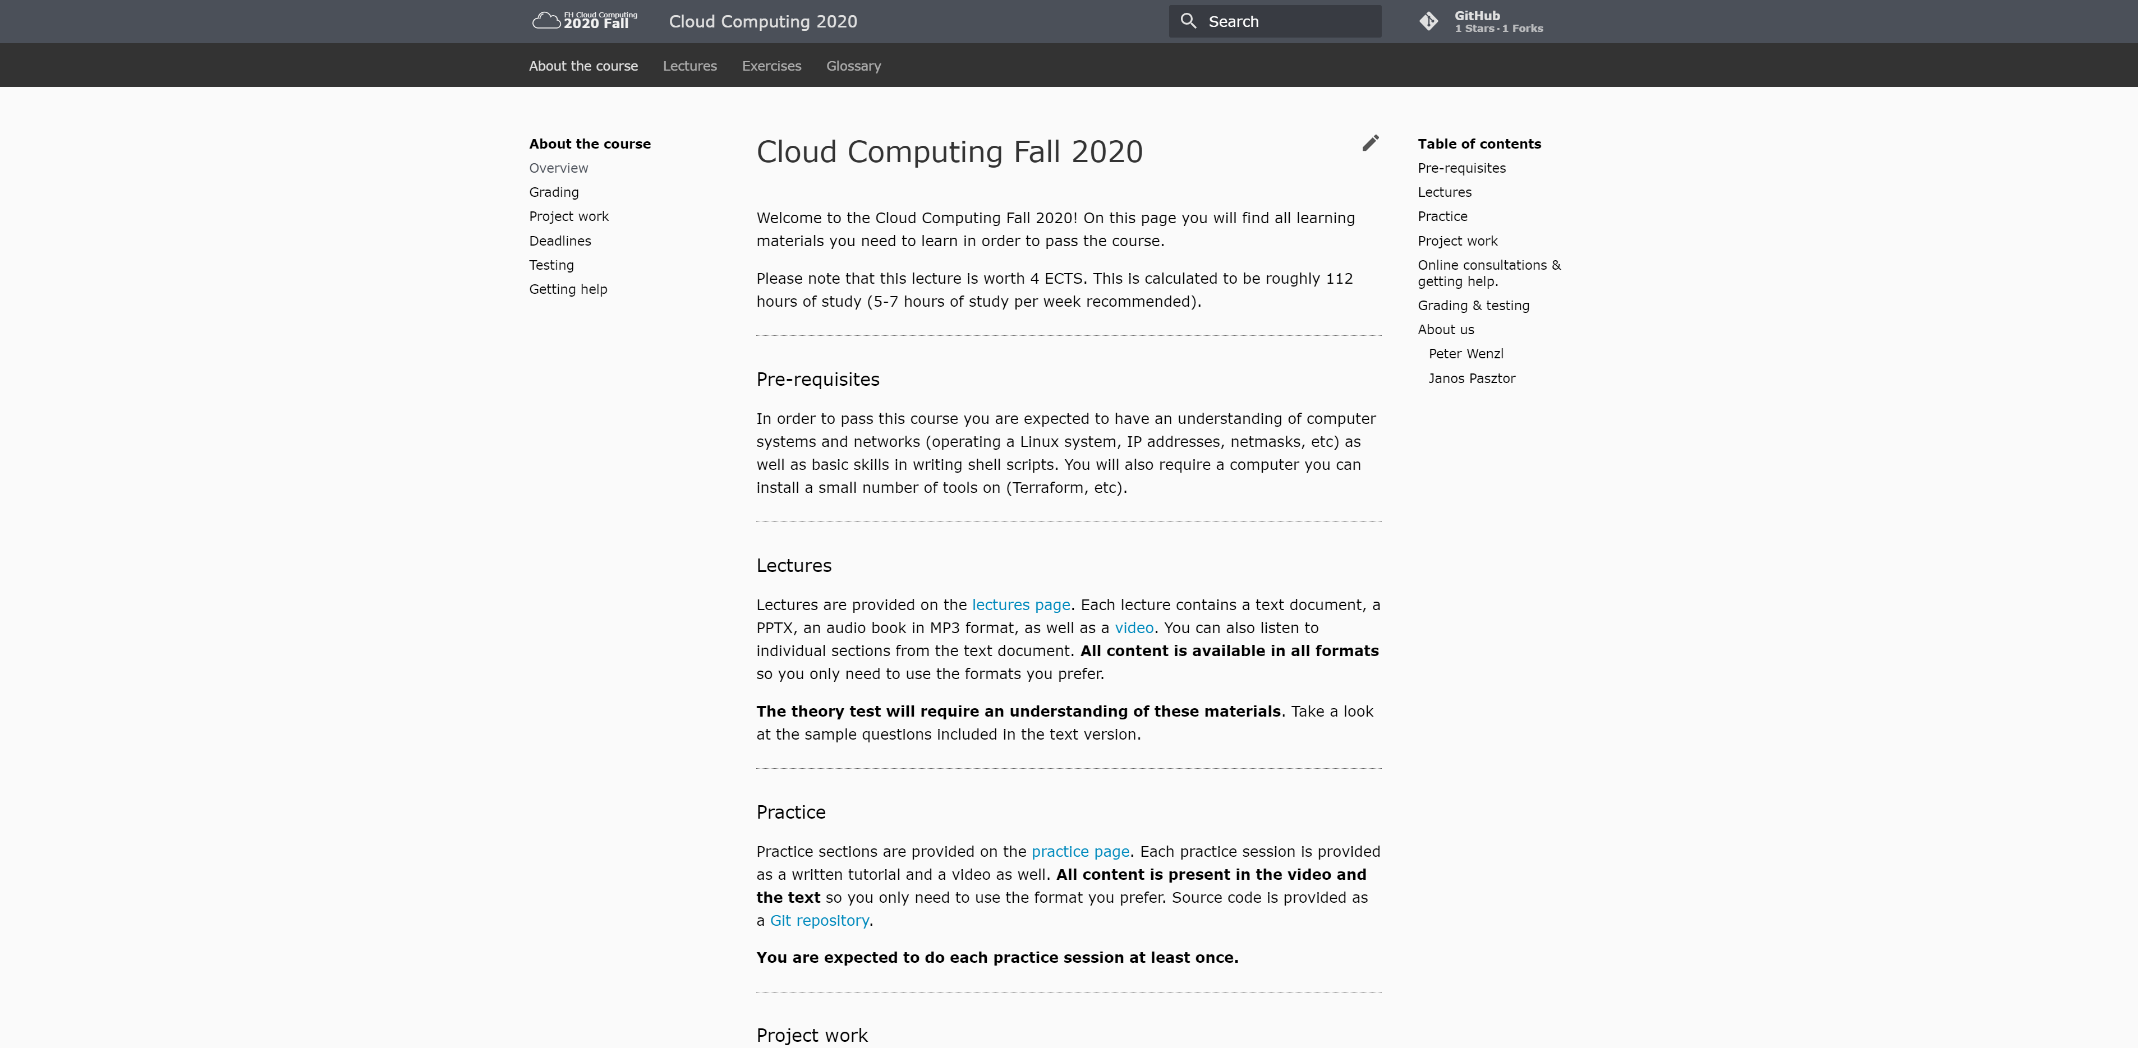
Website
https://fh-cloud-computing.github.io

Slide 9
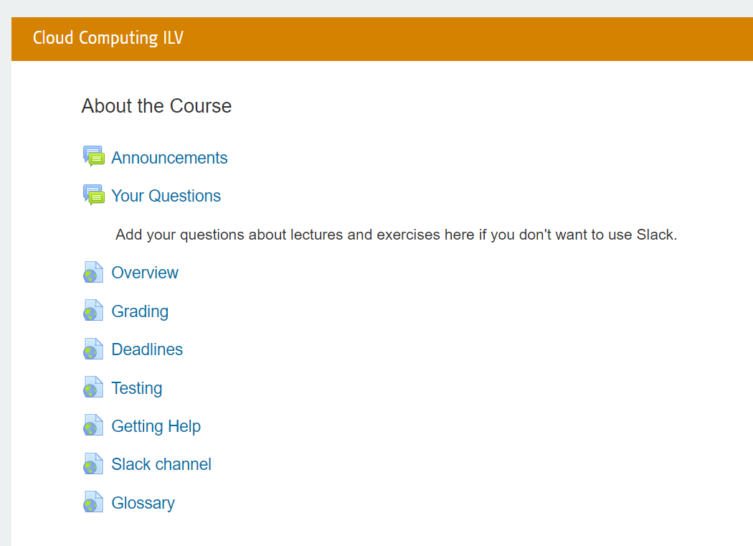
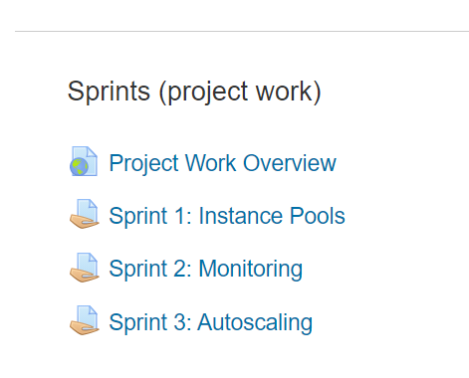
Moodle

Slide 10
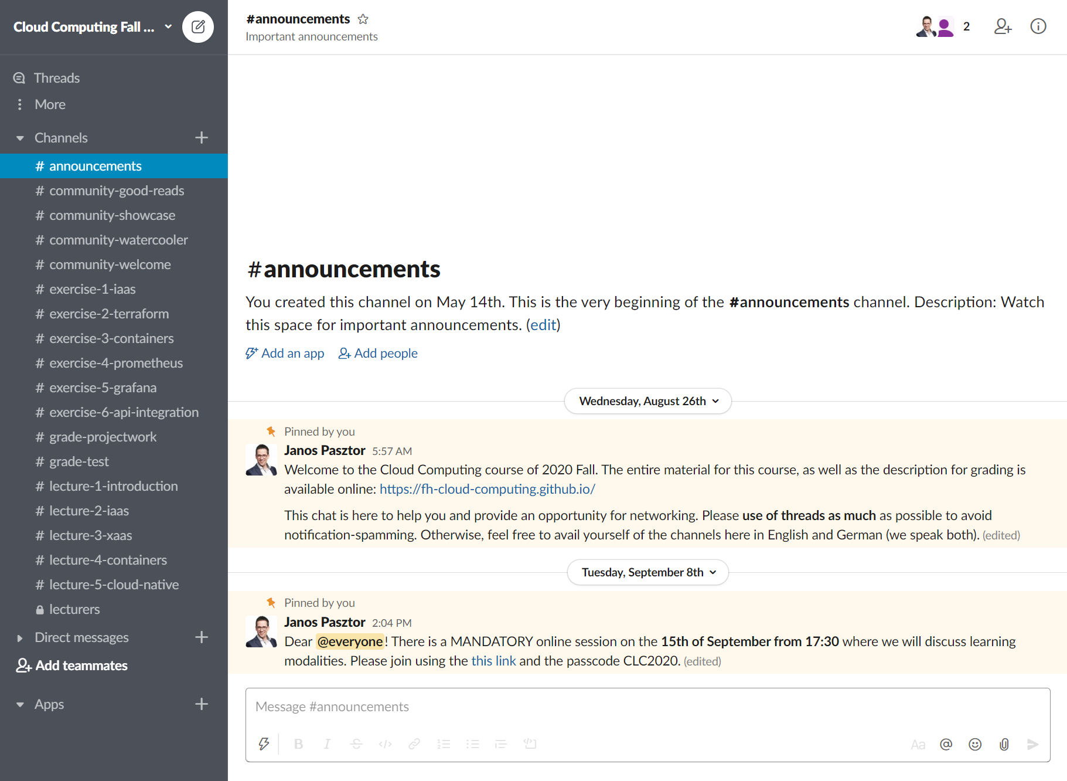
Slack

Slide 11

Lectures
Source: Unsplash/Mohammad Shahhosseini under Unsplash License

Slide 12
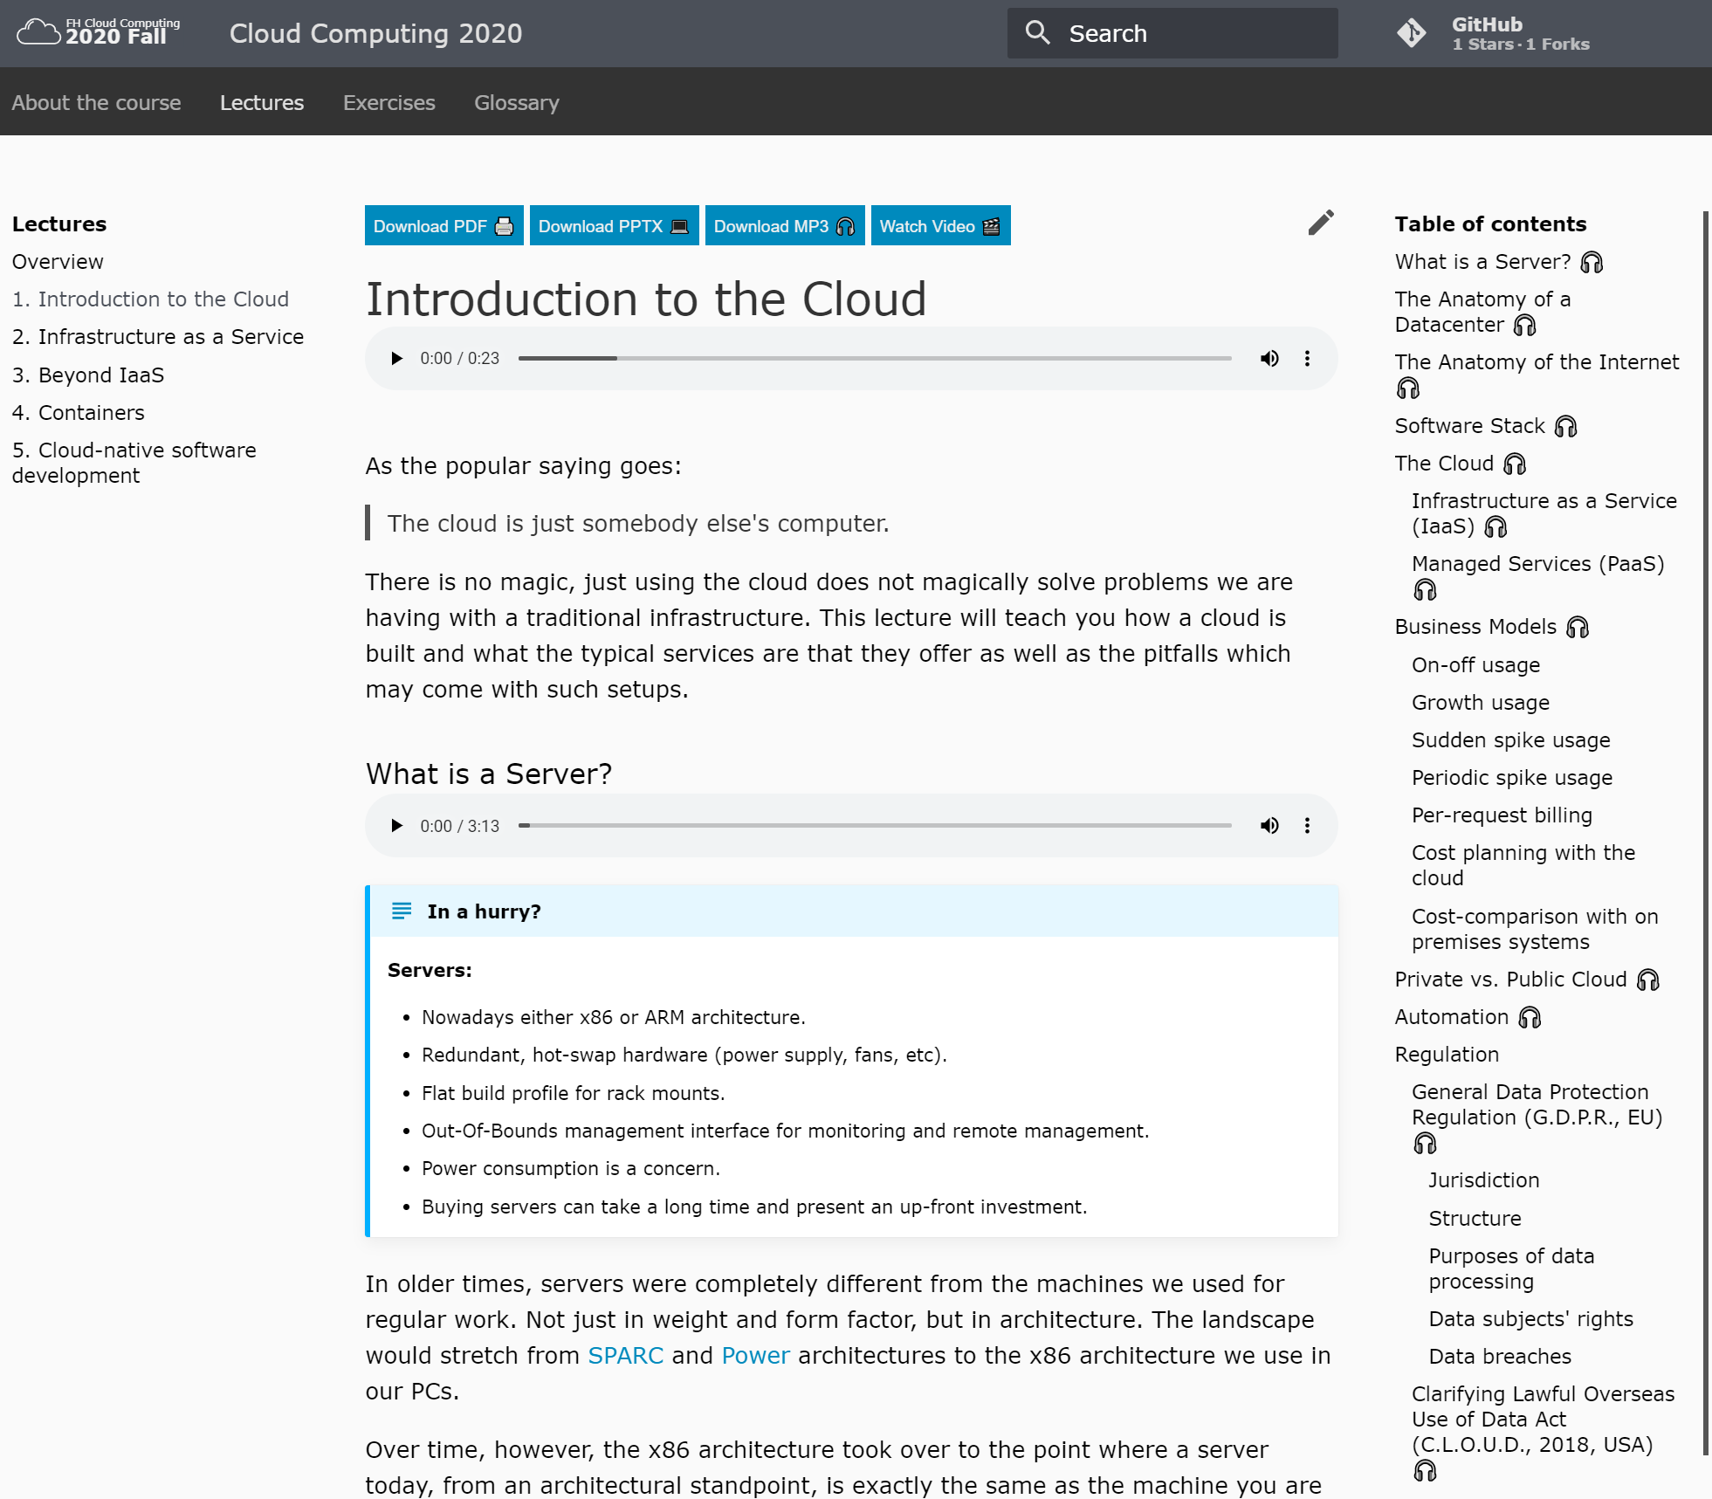
Lecture format

Slide 13
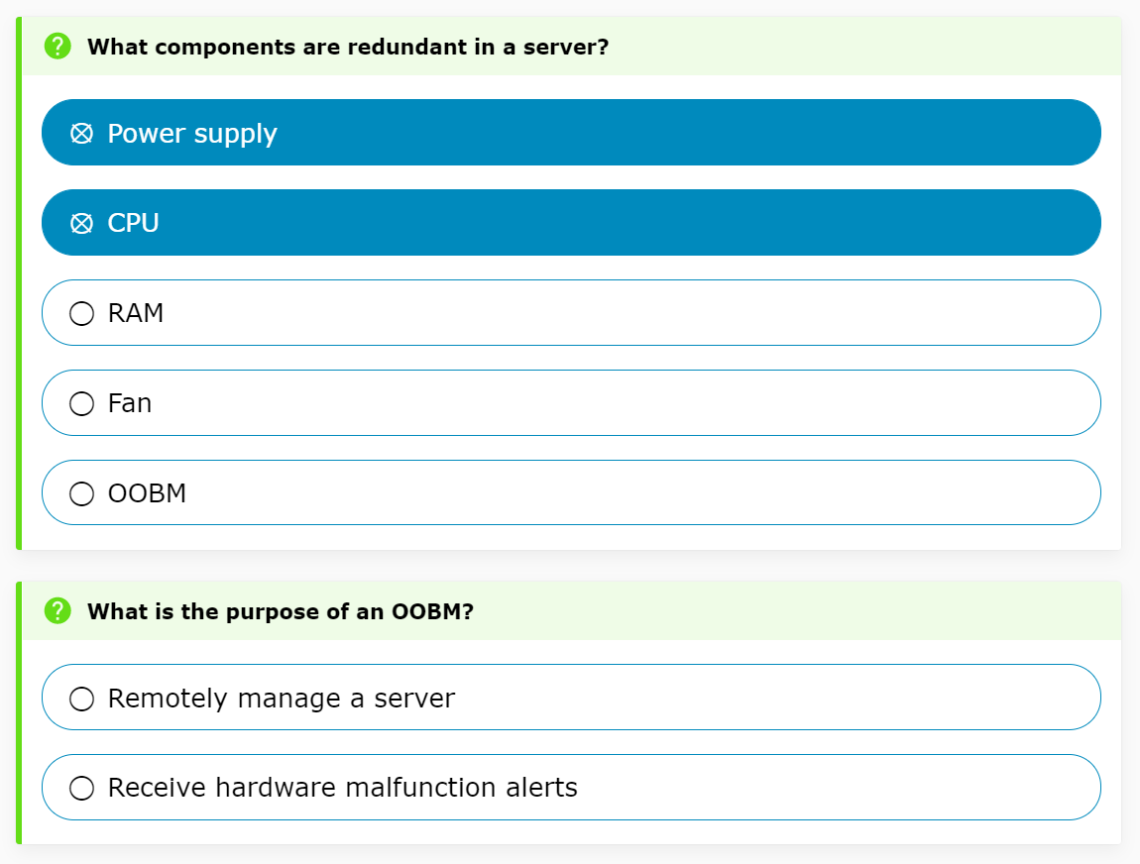
Lecture format

Slide 14
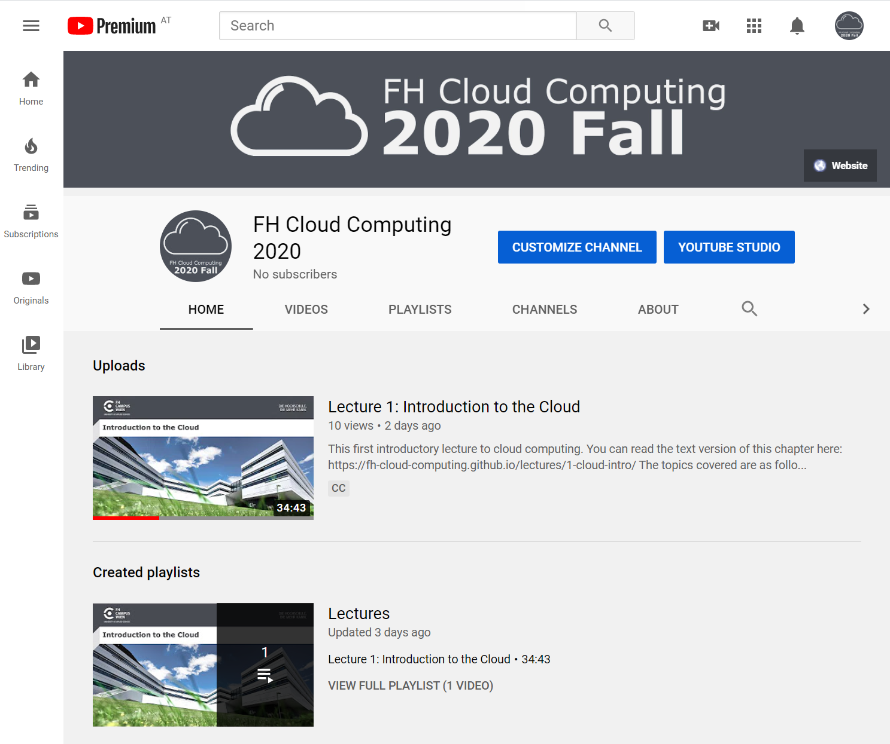
Lecture format

Slide 15
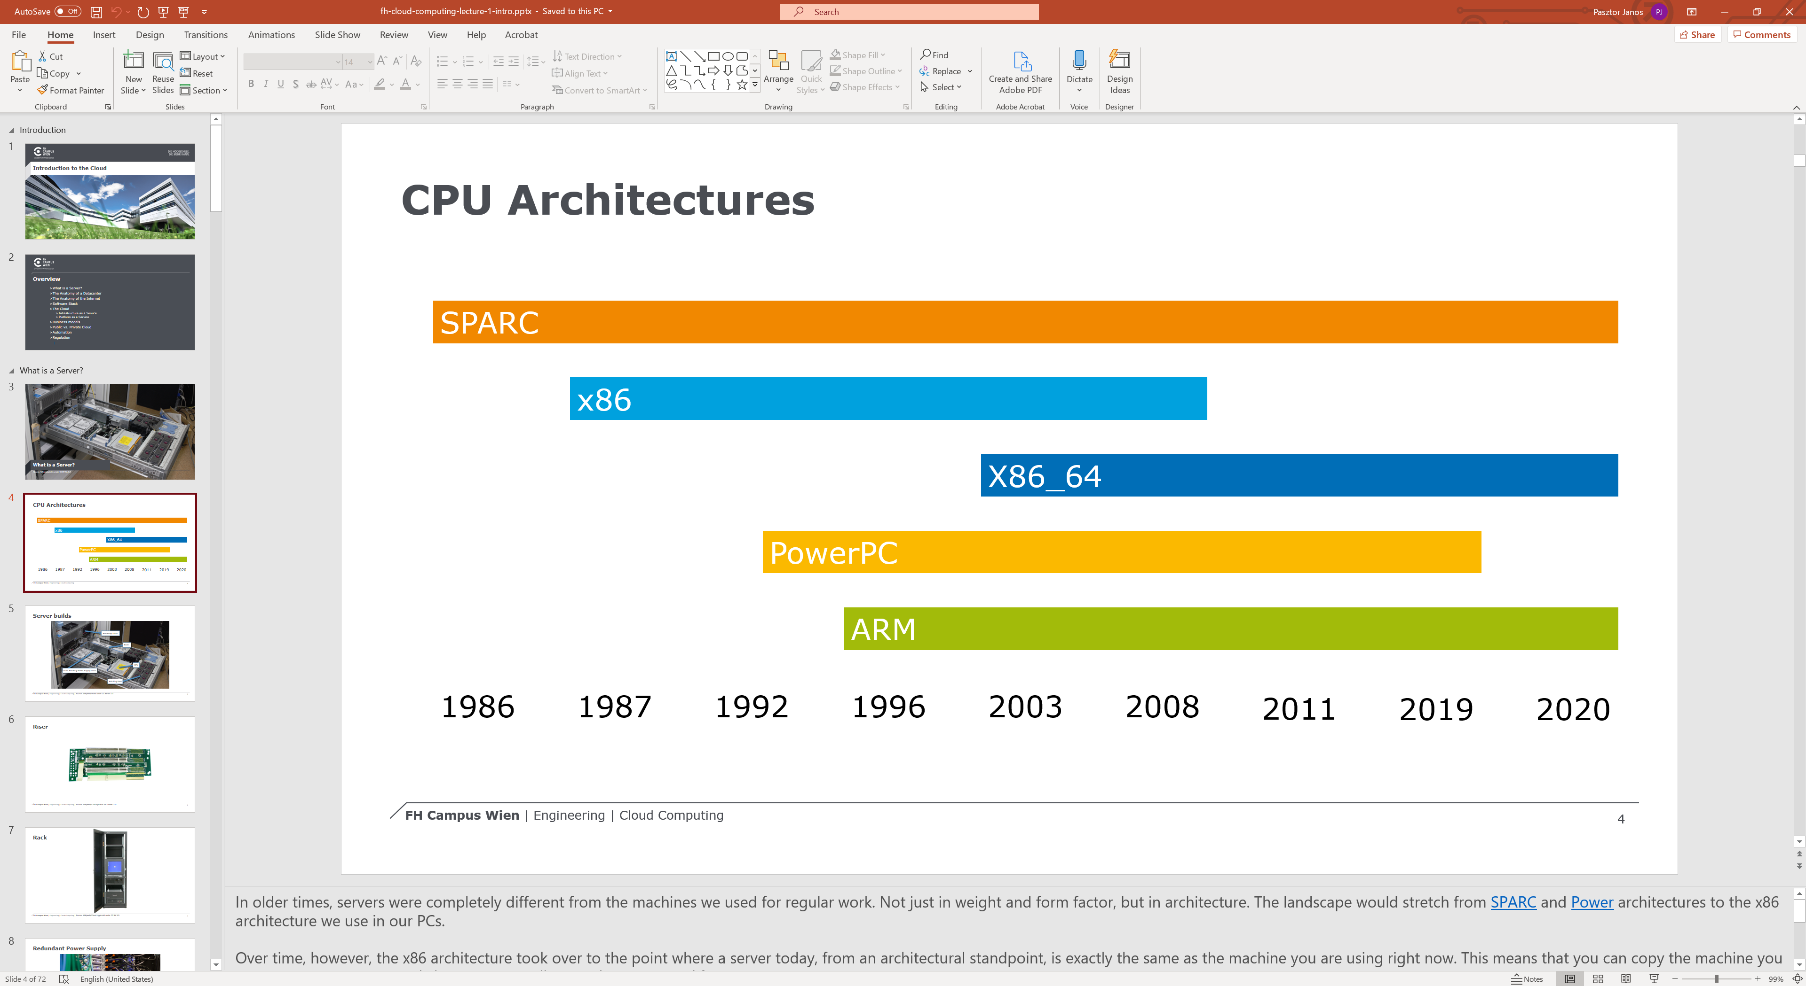
Lecture format

Slide 16
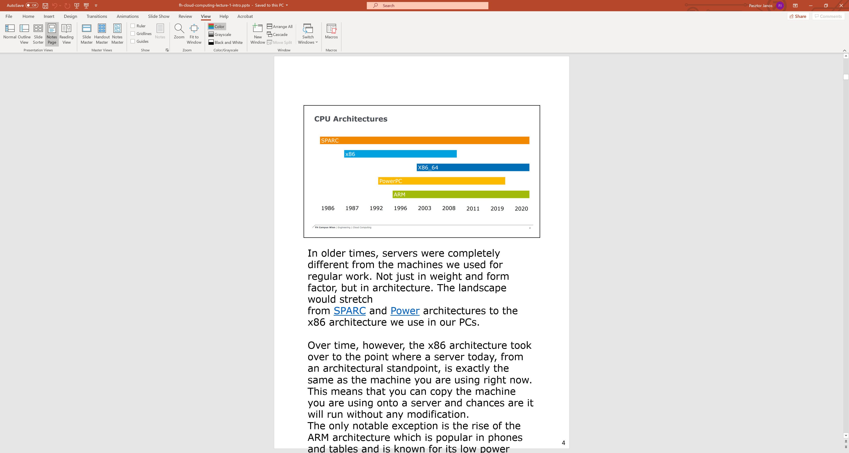
Lecture format

Slide 17

Exercises
Source: Unsplash/John Cameron under Unsplash License

Slide 18
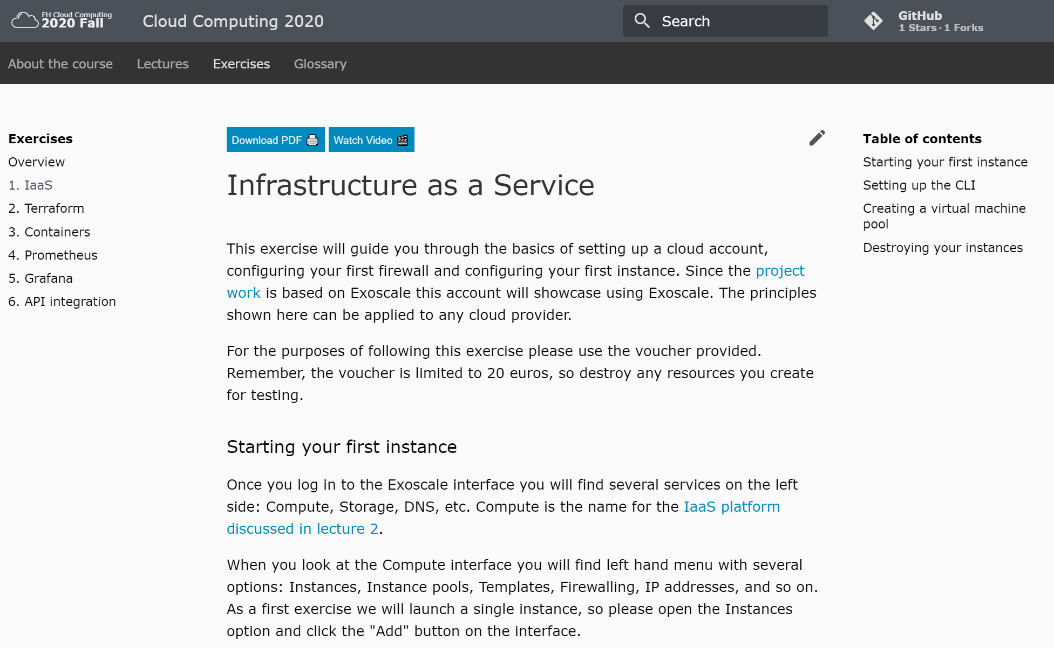
Exercises

Slide 19

Project work
Source: Unsplash/Jo Szczepanska under Unsplash License

Slide 20
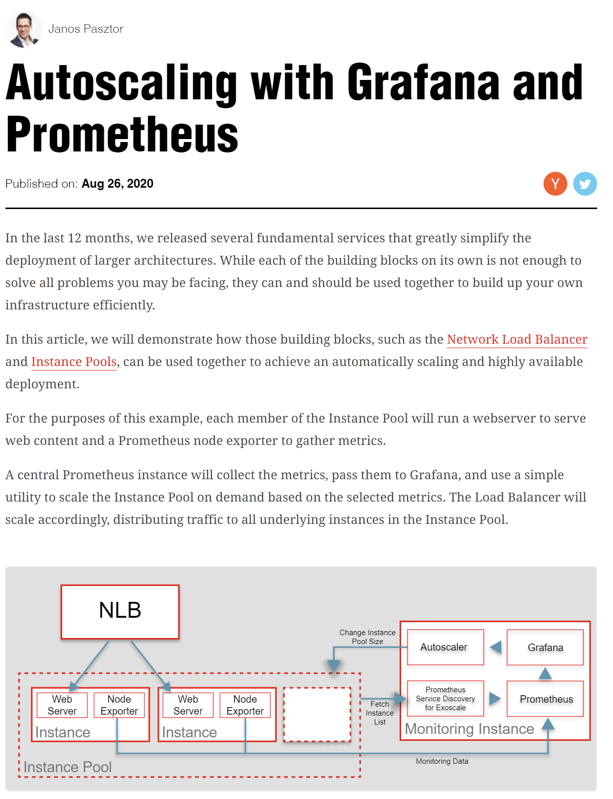
The project

Slide 21
Budget
20 €
-15% to your grade if you run out

Slide 22


Tooling

Slide 23
Architecture
Network Load Balancer
Monitoring VM
SD
Autoscaler
VM
VM
VM
Prometheus
Grafana
Instance Pool

Slide 24
General rules
If you use Terraform, add a Git link in Moodle.
Random solutions will be selected for manual review. Please be prepared to explain your solution.
If you set up manually, contact us for a review appointment.

Slide 25
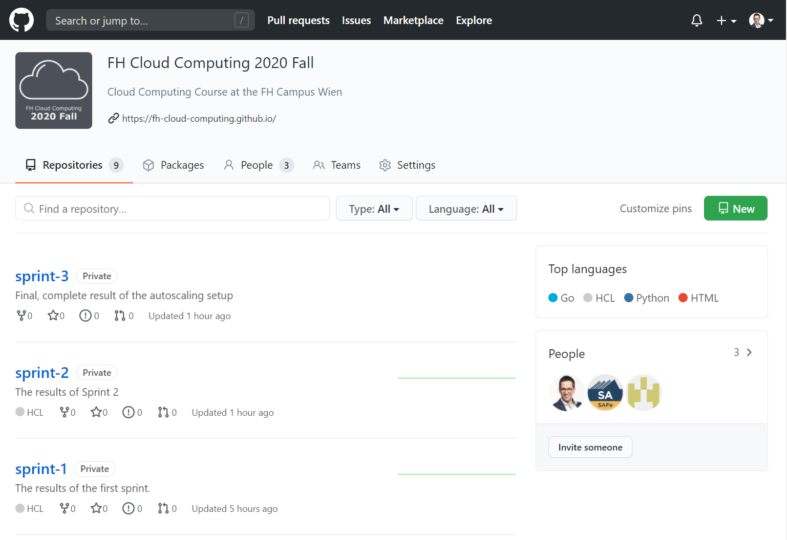
Solutions
Released 5 days after the deadline.
Can be used as a basis for the next sprint.
https://github.com/FH-Cloud-Computing

Slide 26

Deadlines
Source: Unsplash/Kevin Ku under Unsplash License

Slide 27
October 15: Project Work Sprint 1
Set up Load Balancer and Instance pool.
Solution will be released on October 20.

Slide 28
November 15: Project Work Sprint 2
Monitor instances in an instance pool.
Solution will be released on October 20.

Slide 29
December 15: Project Work Sprint 3
Full auto-scaling.
Solution will be released on October 20.

Slide 30

Grading
Source: Unsplash/Annie Spratt under Unsplash License

Slide 31
Overview
55% written exam (must reach 60% to score)
45% project work

Slide 32
Sprint 1: Instance Pool & NLB
5% for having a working instance pool and NLB
10% for having a fully automated setup using Terraform

Slide 33
Sprint 2: Monitoring
5% for having a working monitoring
5% for having a fully automated setup using Terraform
5% for implementing the Prometheus service discovery yourself

Slide 34
Sprint 3: Autoscaling
5% for having a working monitoring
5% for having a fully automated setup using Terraform
5% for implementing the Prometheus service discovery yourself

Slide 35
Exoscale Budget Overrun
-15% if your Exoscale account runs out of budget

Slide 36
Summary
55% written exam
45% project work
15% Sprint 1: Instance Pool & NLB
5% for having a working instance pool and NLB
10% for having a fully automated setup using Terraform
15% Sprint 2: Monitoring
5% for having a working monitoring
5% for having a fully automated setup using Terraform
5% for implementing the Prometheus service discovery yourself
15% Sprint 3: Autoscaling
5% for having a working monitoring
5% for having a fully automated setup using Terraform
5% for implementing the Prometheus service discovery yourself
-15% if your Exoscale account runs out of funds

Slide 37
Marks
100%-90%: 1
89%-80%: 2
79%-70%: 3
69%-60%: 4
60%-0%: 5
You must score at least 60% on the theory test to pass.

Slide 38

Thank you!
Source: Unsplash/Wilhelm Gunkel under Unsplash License

